Slide 1
ML Basics
CS4981 ML Production Systems
RJ Nowling

Slide 2
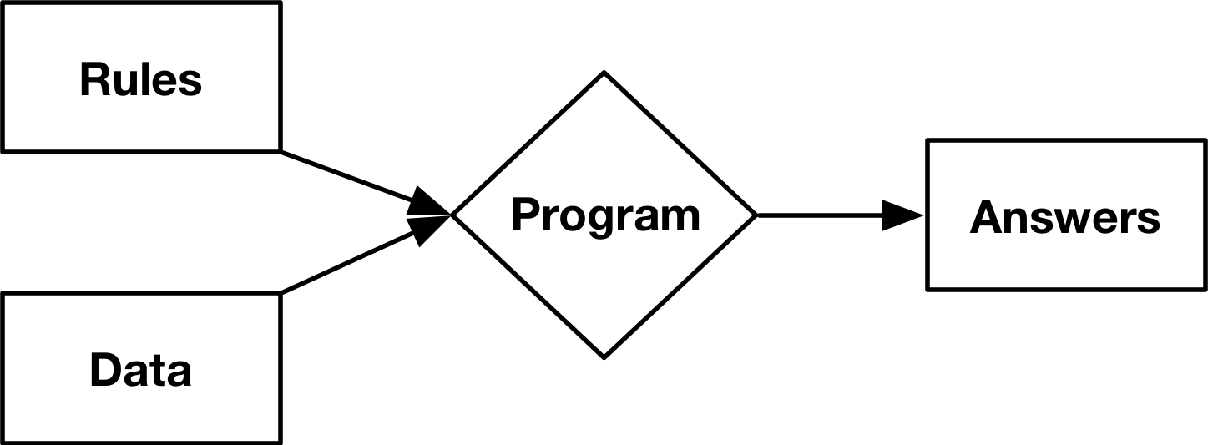
Traditional Programming

Slide 3
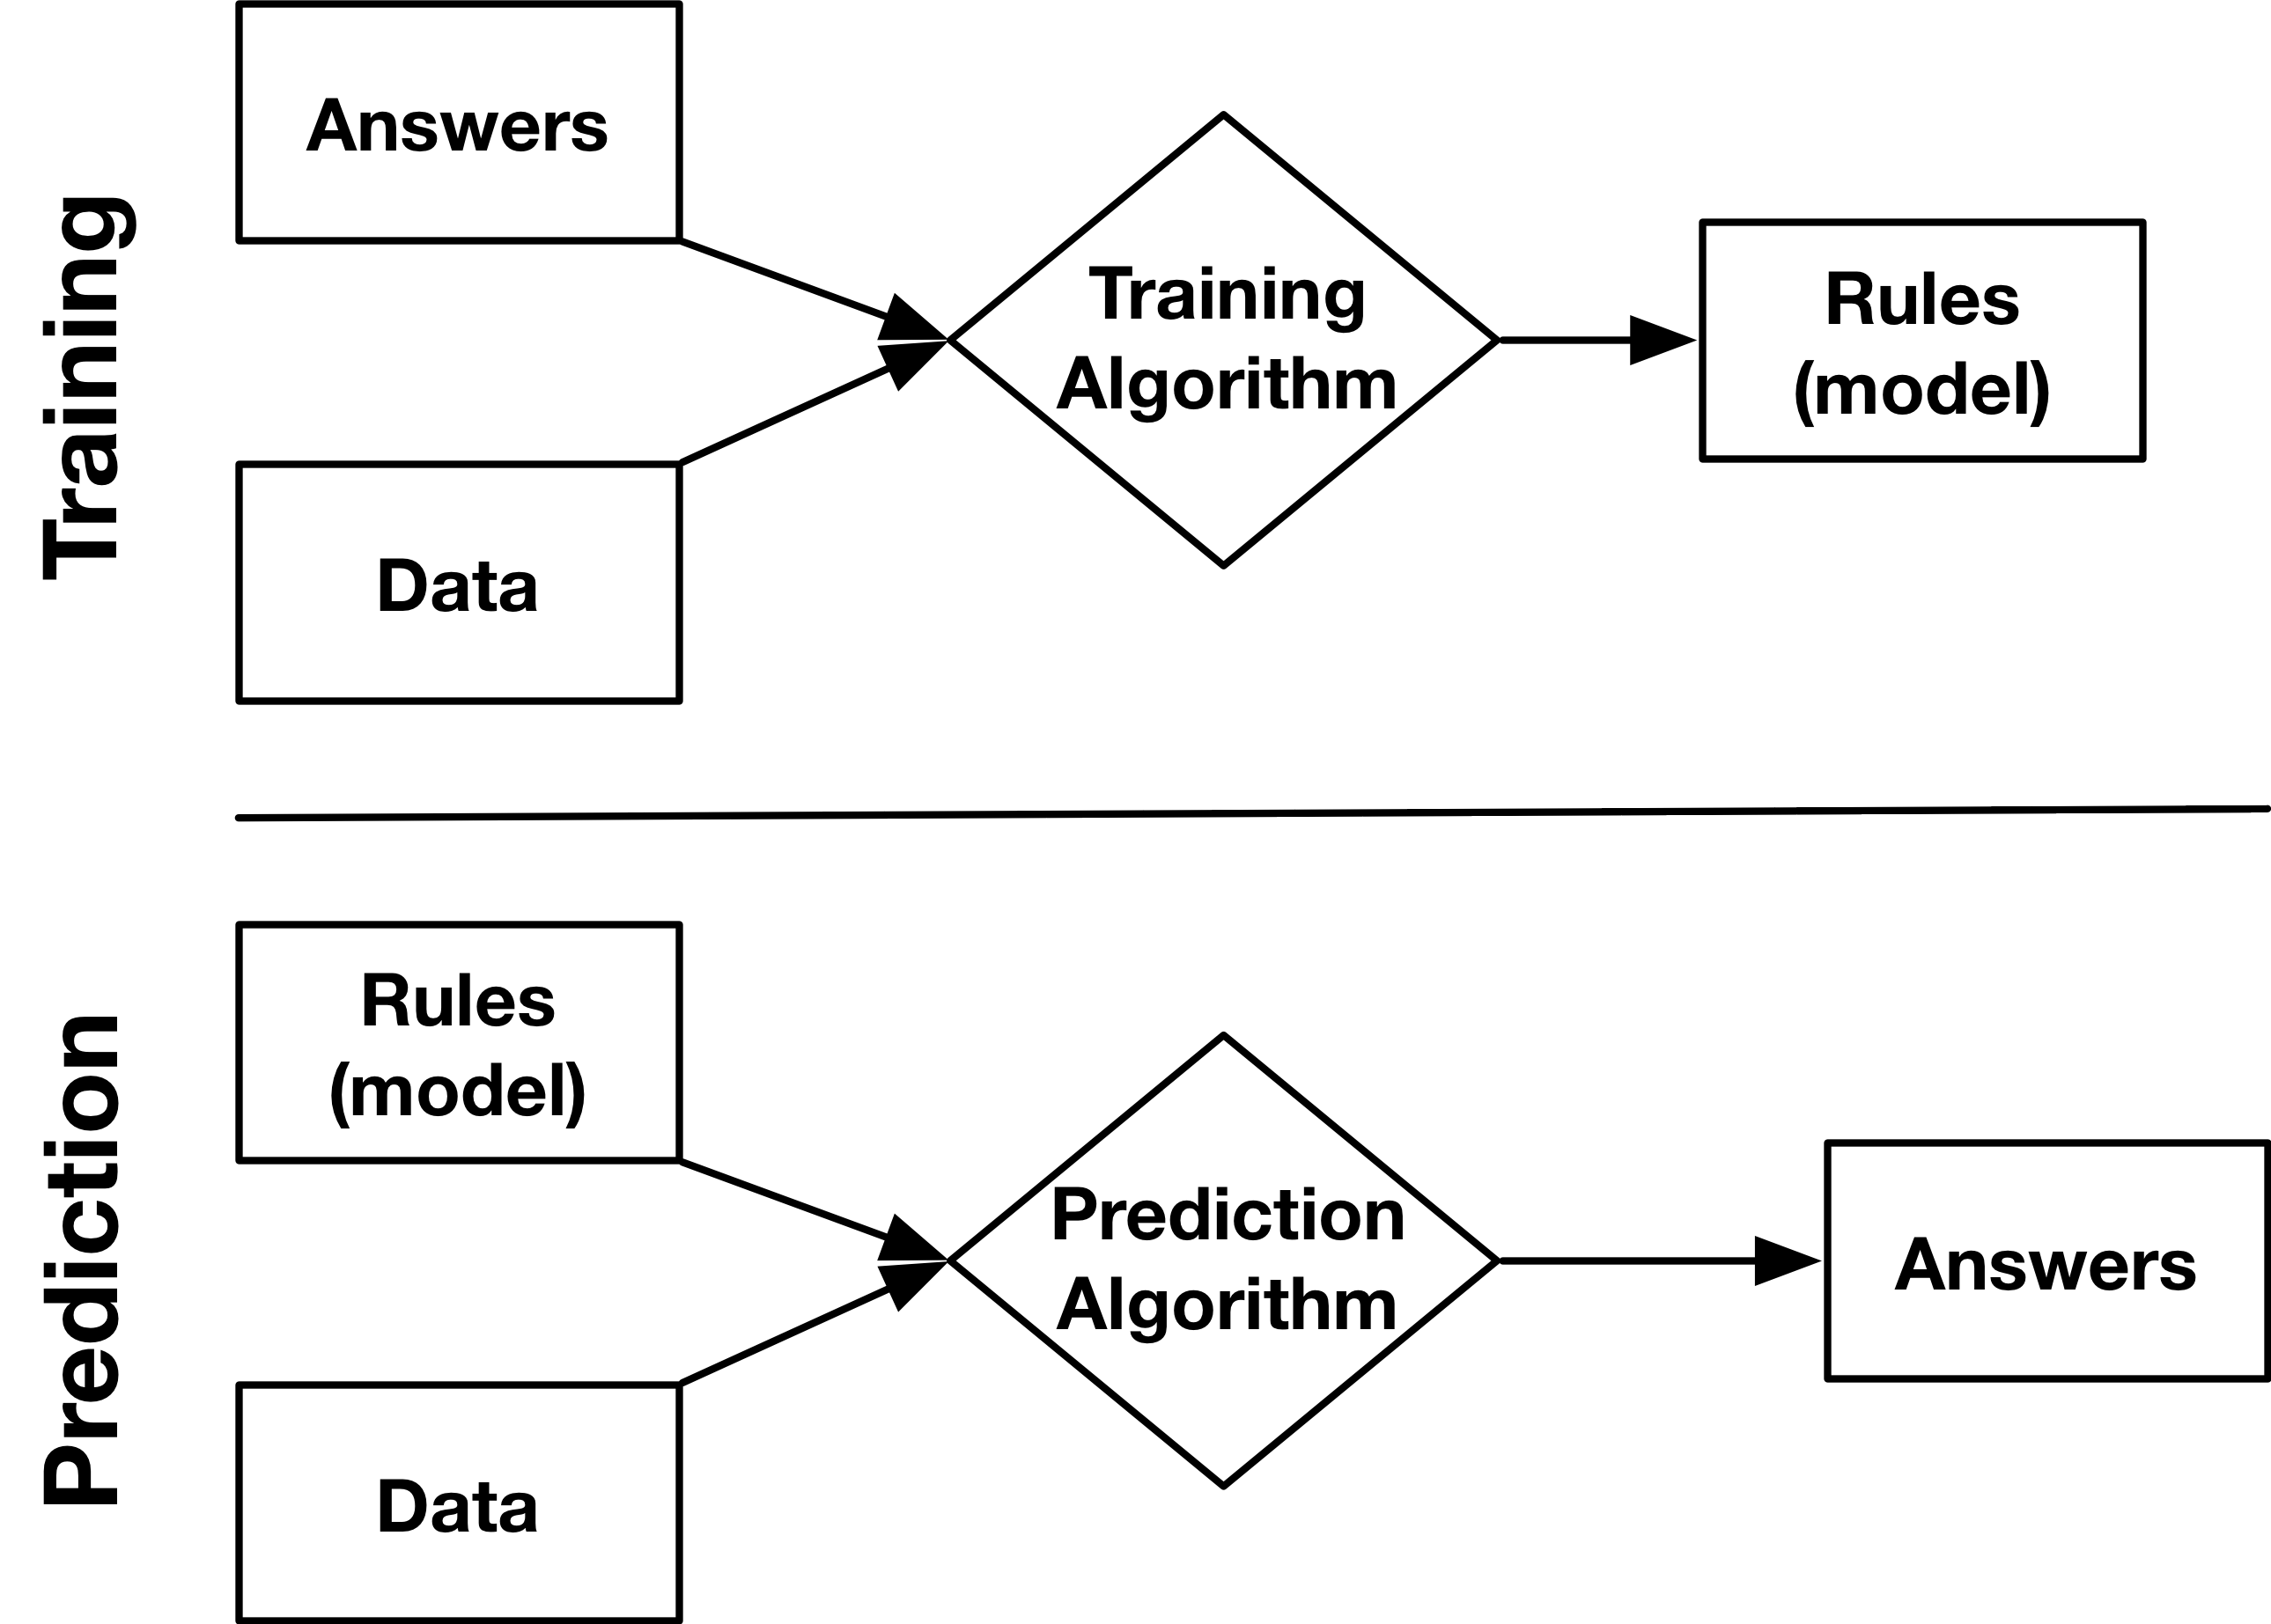
Supervised Machine Learning

Slide 4
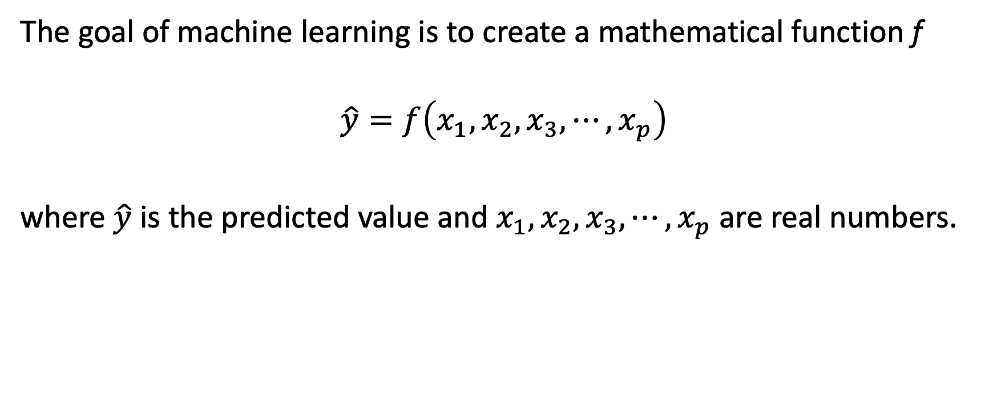
Supervised Machine Learning
The goal of machine learning is to create a mathematical function f
$$\hat{y}=f\left(x_{1},x_{2},x_{3},⋯,x_{p}\right)$$
where $\hat{y}$ is the predicted value and $x_{1},x_{2},x_{3},⋯,x_{p}$ are real numbers.

Slide 5
Supervised Learning Problem
Regression (continuous output):
How much will be the sale price of this house?
How large will an algae bloom be?
What will a students' GPA be at graduation?
Classification (categorical output):
Is the animal in the picture a cat or dog?
Is this a negative or positive review?
Is this genomic sequence a gene or not?

Slide 6
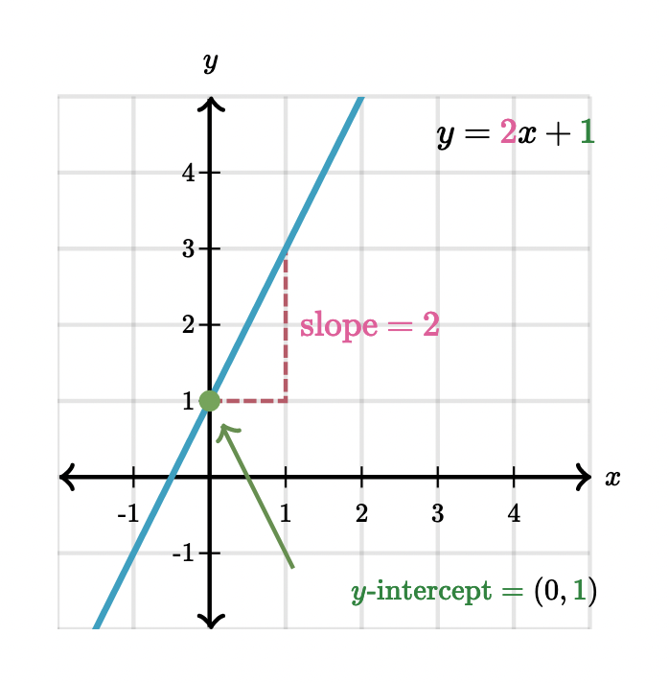
Modeling a Line
In high school algebra, you learned how to find the line that passed through two points

Slide 7
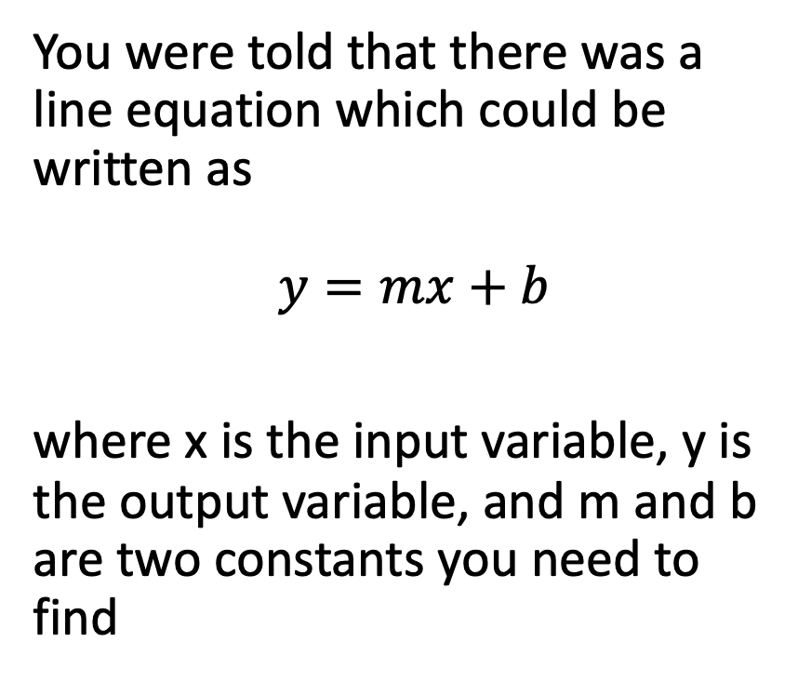
Modeling a Line
You were told that there was a line equation which could be written as $$y=mx+b$$
where x is the input variable, y is the output variable, and m and b are two constants you need to find

Slide 8

Modeling a Line
Given two points (x₁, y₁) and (x₂, y₂), you can find m as follows:
$$m= \frac{y_{2}−y_{1}}{x_{2}−x_{1}}$$

Slide 9

Modeling a Line
For example:
$$m= \frac{y_{2}−y_{1}}{x_{2}−x_{1}}$$
$$=\frac{2 −1}{1 −0}$$
$$=2$$

Slide 10

Modeling a Line
Knowing m, you can find b as follows:
$$b=y_{1}−mx_{1}$$

Slide 11

Modeling a Line
Knowing m, you can find b as follows:
$$b=y_{1}−mx_{1}$$
$$=1−2\left(0\right)$$
$$=1$$

Slide 12

Our Equation
Knowing m, you can find b as follows:
$$y=2x+1$$

Slide 13
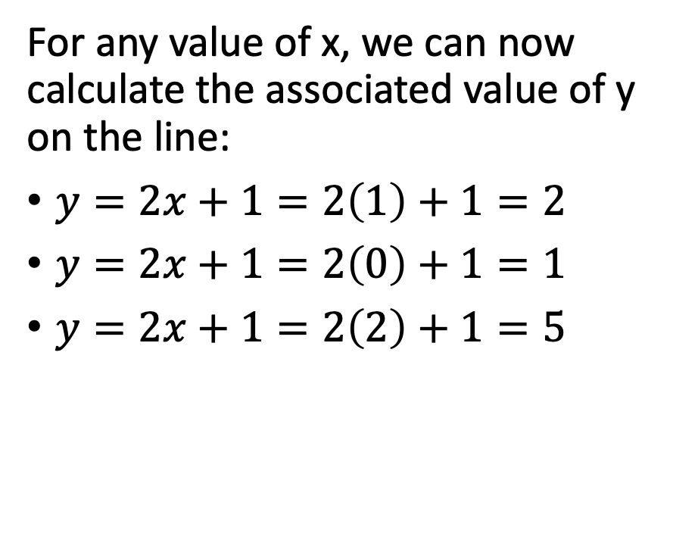
Reproducing y
For any value of x, we can now calculate the associated value of y on the line:
$y=2x+1=2\left(1\right)+1=2$
$y=2x+1=2\left(0\right)+1=1$
$y=2x+1=2\left(2\right)+1=5$

Slide 14
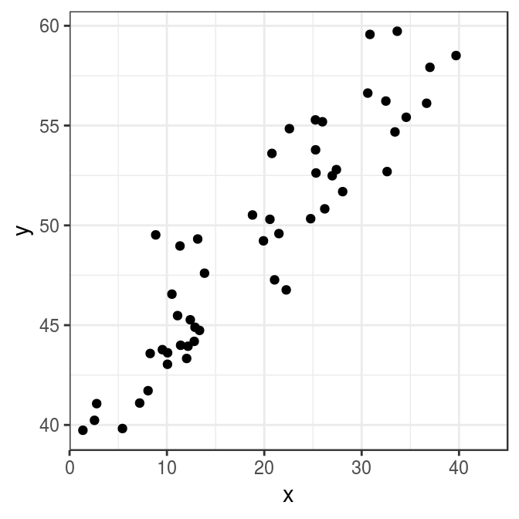
Many Points
What if we have more than 2 points?
Our line model can no longer exactly the predict the y value for every x
How do we go about finding a line that approximates the y values?

Slide 15
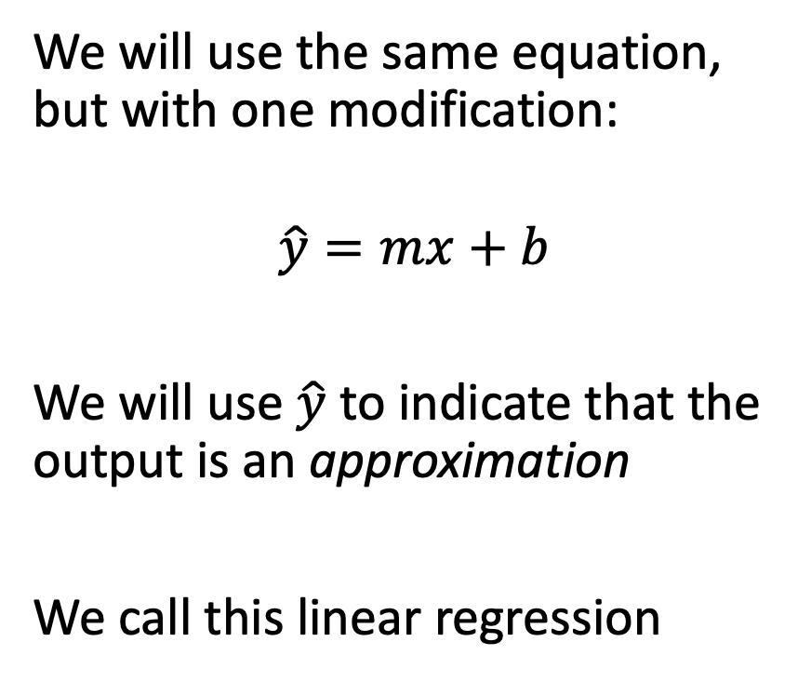
Simple Linear Regression
We will use the same equation, but with one modification:
$$\hat{y}=mx+b$$
We will use $\hat{y}$ to indicate that the output is an approximation
We call this linear regression

Slide 16
Ordinary Least Squares
We will need to solve for m and b using a different method.
We will use the ordinary least squares estimator (process not shown)

Slide 17
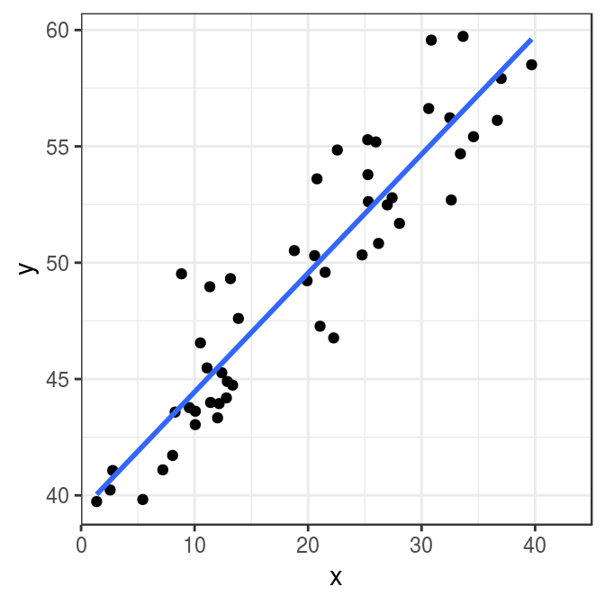

Many Points
The resulting equation (model):
$$\hat{y}=\text{0.51}x\text{ + }\text{39.34}$$

Slide 18
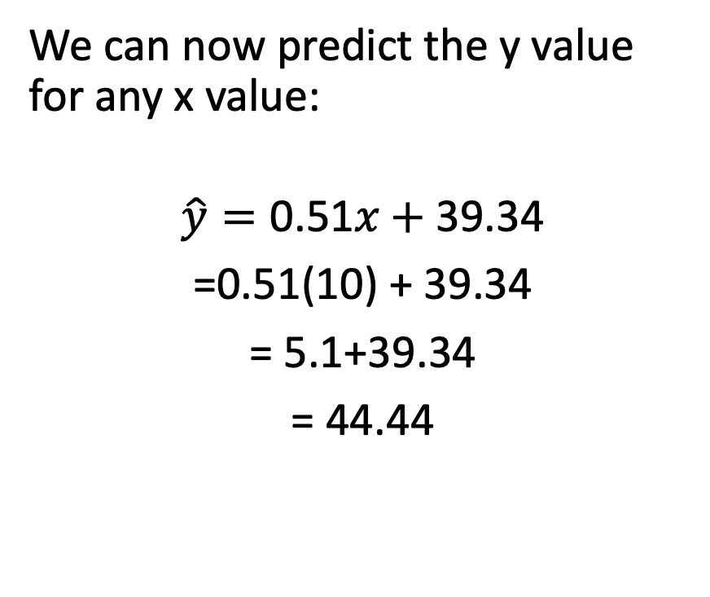
Predicting values
We can now predict the y value for any x value:
$$\hat{y}=\text{0.51}x\text{ + }\text{39.34}$$
=0.51(10) + 39.34
= 5.1+39.34
= 44.44

Slide 19
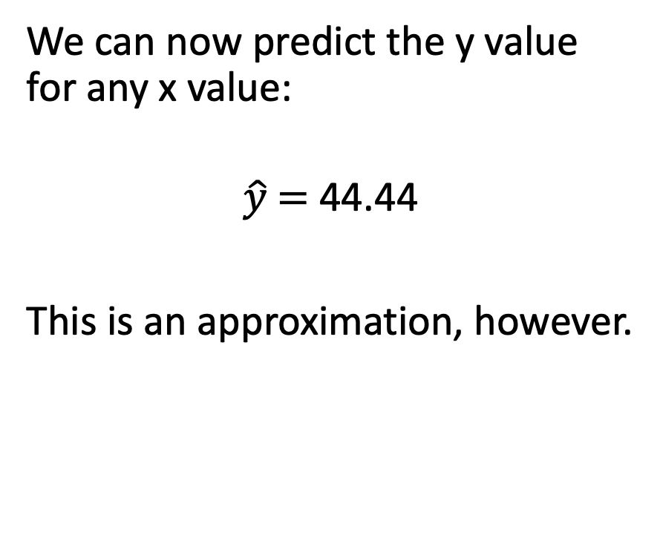
Predicting values
We can now predict the y value for any x value:
$$\hat{y}\text{ = }\text{44.44}$$
This is an approximation, however.

Slide 20
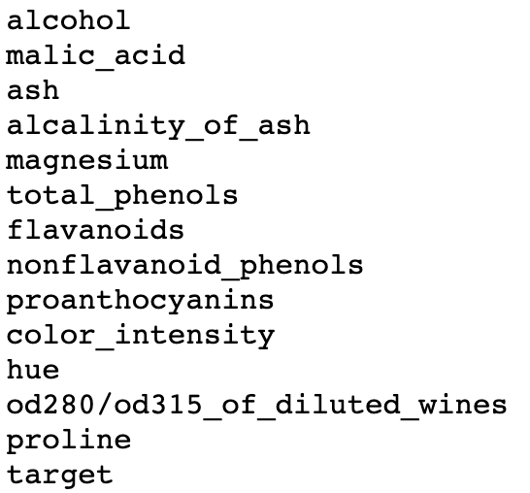
Wine Data Set
Data recorded for 178 wine bottles
3 types of wine ("target")
13 numerical features

Slide 21
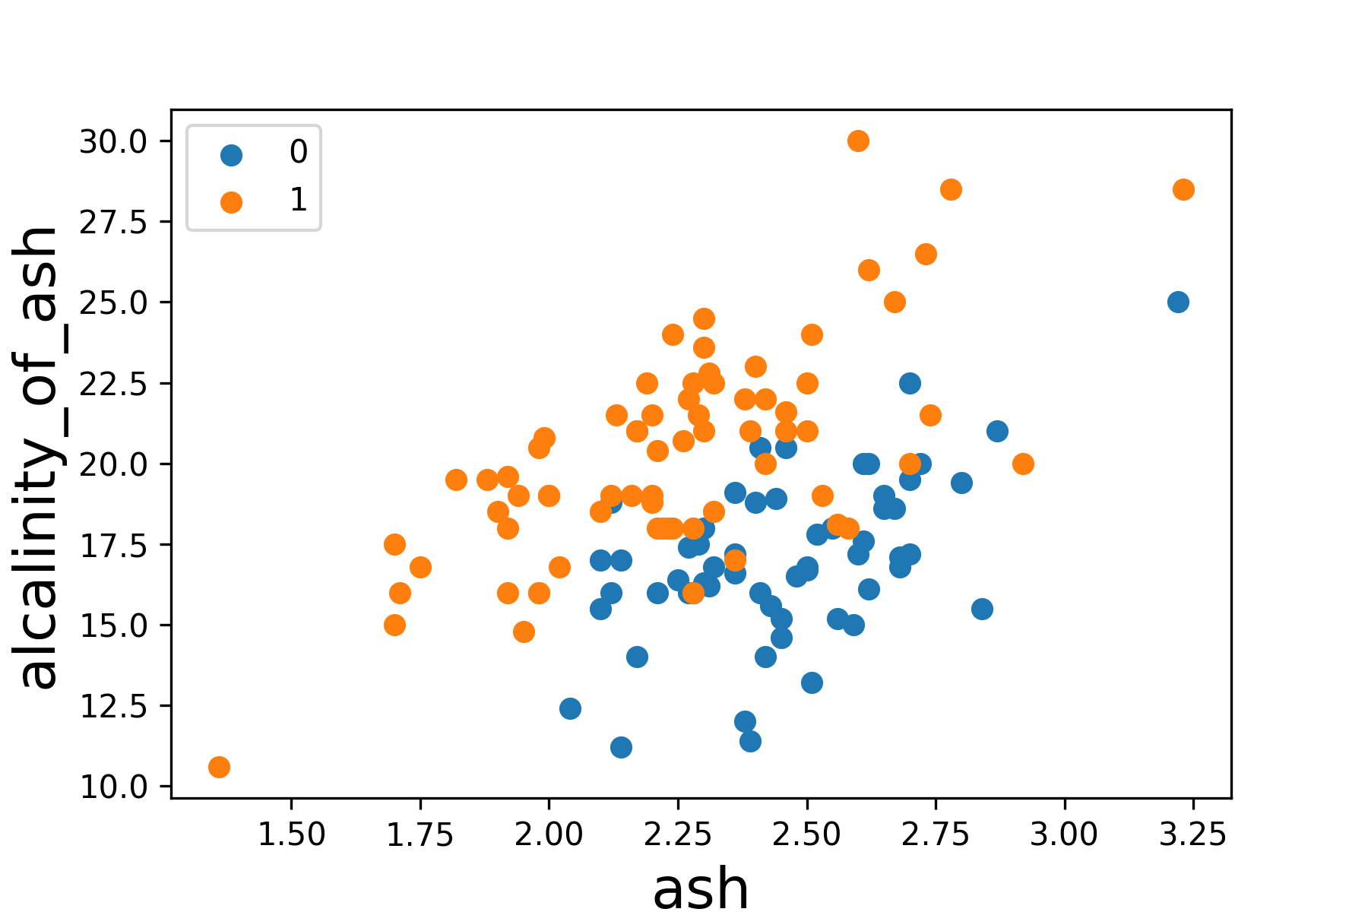
Labeled Points

Slide 22
Learned Decision Boundary

Slide 23
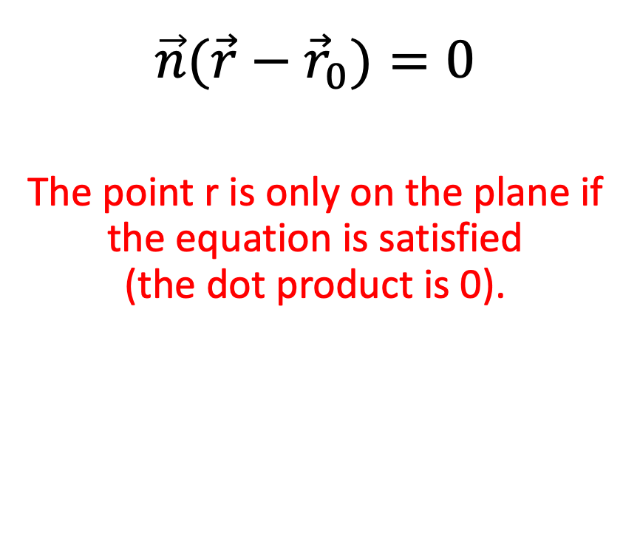
Classification with a Plane
$$\vec{n}(\vec{r}−{\vec{r}}_{0})=0$$
The point r is only on the plane if the equation is satisfied (the dot product is 0).

Slide 24
Classification with a Plane
$$\vec{n}\left(\vec{r}−{\vec{r}}_{0}\right)>0$$
If the result is not zero, we can use the equation to determine what side of the plane the point r is located on

Slide 25
Classification with a Plane
$$\vec{n}\left(\vec{r}−{\vec{r}}_{0}\right)<0$$
If the result is not zero, we can use the equation to determine what side of the plane the point r is located on

Slide 26
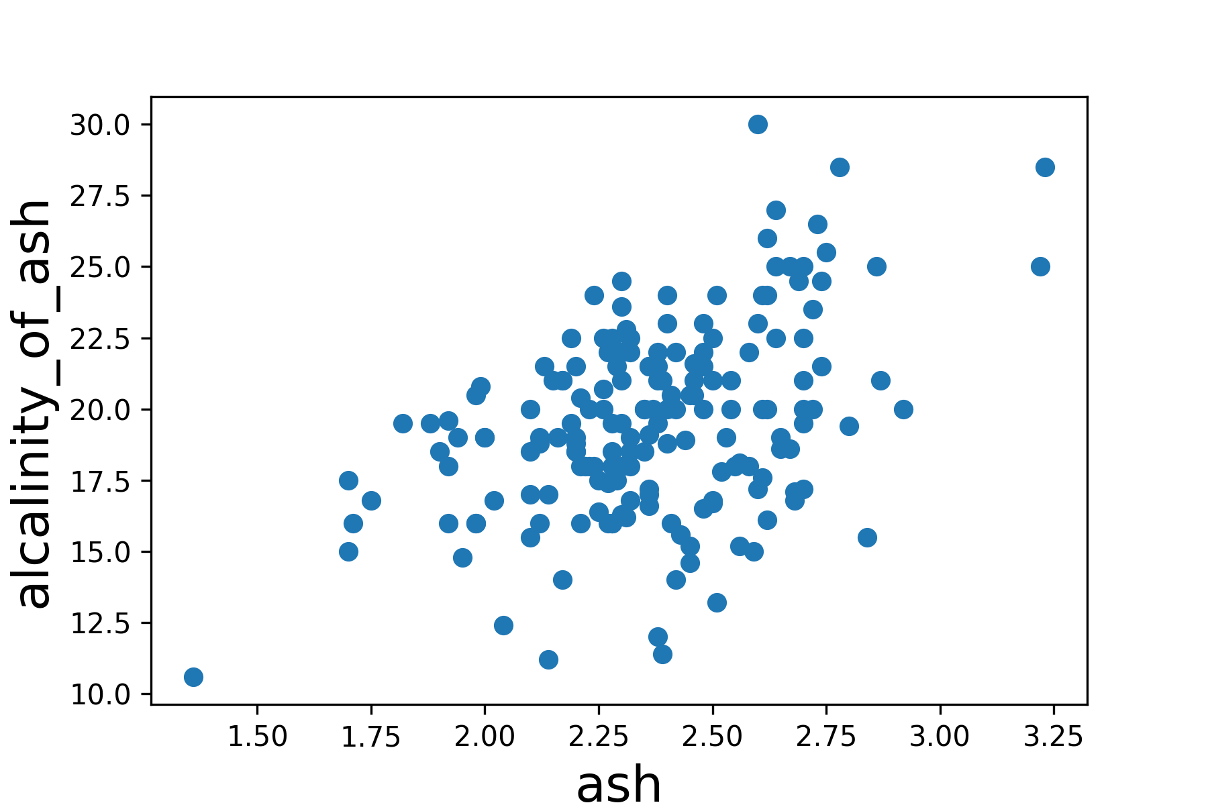
Represent Unlabeled Points

Slide 27
Load Decision Boundary

Slide 28
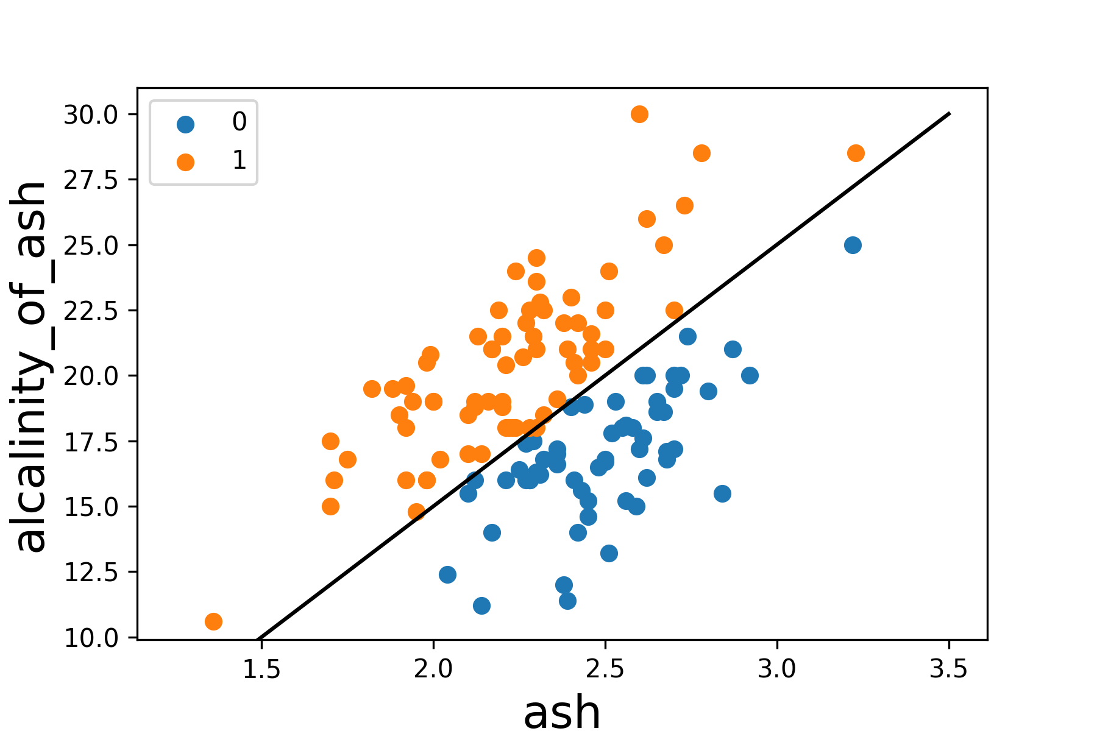
Predict Labels for the Points

Slide 29
Common Supervised Algorithms
Regression
Classification
Linear Regression
k-Nearest Neighbors (kNN) Regression
Random Forests
Neural Networks
Logistic Regression
k-Nearest Neighbors (kNN)
Random Forests
Support Vector Machines (SVMs)
Naïve Bayes
Neural Networks

